Slide 1
IS883: Synthesizing Digital Efforts
Mohannad Elhamod

Slide 2
Language Modeling

Slide 3
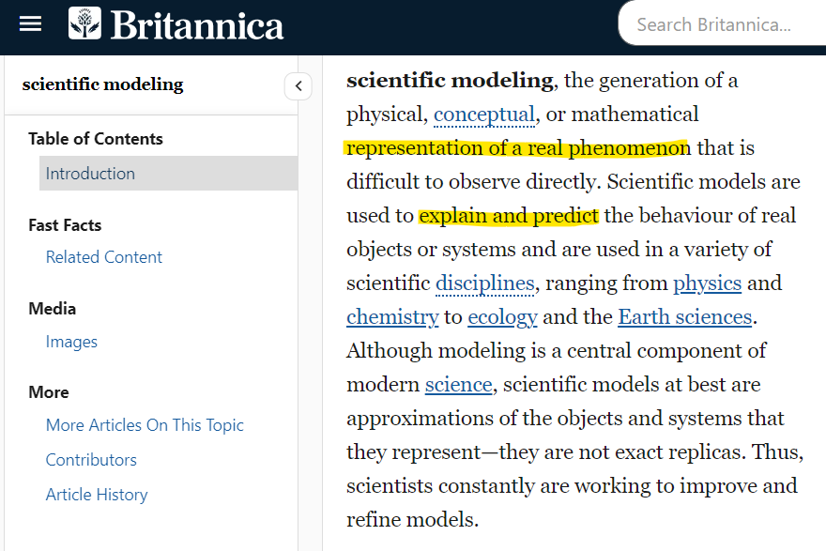
What does a model mean?
Notes:
Language modeling is getting the probability or predicting what comes next.

Slide 4

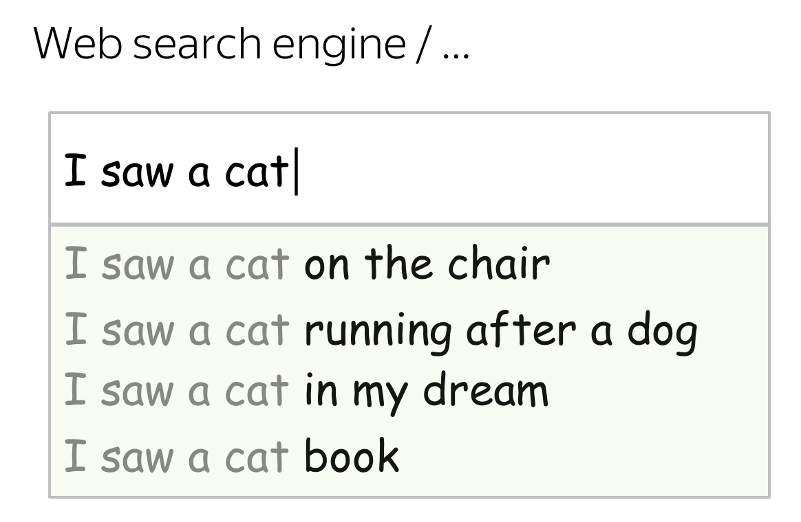
What is language modeling anyway?...
Lena-voita
Notes:
Language modeling is getting the probability or predicting what comes next.
How did you know this is the next word?

Slide 5
What is language modeling anyway?...
I grabbed the branch and broke it.
I went to the branch and deposited some money.
Context matters!
Notes:
Context matters
There is relationship between words.

Slide 6
What is language modeling anyway?...
I went to ____.
I woke up at 7 am and went to ___.
I woke up at 7 am, packed my book and notebook, and went to ____.
The more context, the more certain

Slide 7
What is language modeling anyway?...
I went to the branch and deposited some money.
I went to the bank and deposited some money.
I went to the ATM and deposited some money.
Lena-voita
Notes:
Language modeling is getting the probability or predicting what comes next.
How did you know this is the next word?

Slide 8
What is language modeling anyway?...
… watched the water flow.
I sat at the bank and …
… waited for my turn.
We process language sequentially*.
*We will talk about exceptions later...
Notes:
Sequential processing: context can’t look at future for text generation.
How did you know this is the next word?

Slide 9
Natural Language Processing (NLP)
Includes text generation:
Text completion.
Text summarization.
Question answering.
But there are also many other tasks such as Text classification: (e.g., Sentiment analysis, Reviews, Fake news) or word classification.

Slide 10
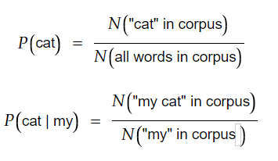
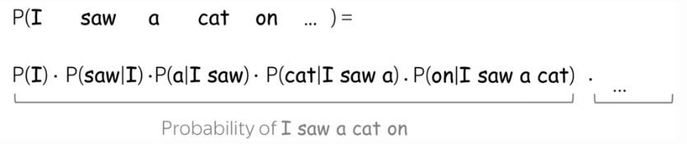
Formalizing our thoughts
So, language modeling is the chaining of word probabilities.
How do we calculate these probabilities?
counting…
Lena-voita
Can you foresee any problem with this calculation?...
Notes:
Problems: this can become a really long calculation
Also, what if word never existed.

Slide 11
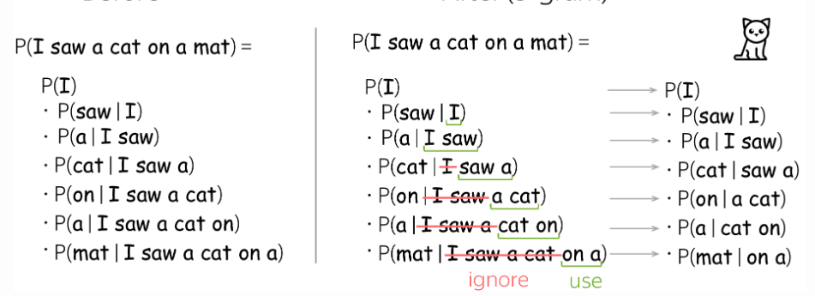
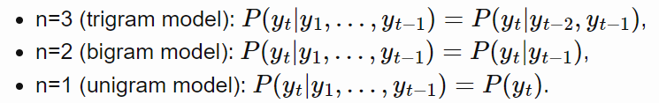
N-grams
Instead, let’s just use a context of fixed-length.
Lena-voita
Notes:
Keep it as a homework.

Slide 12
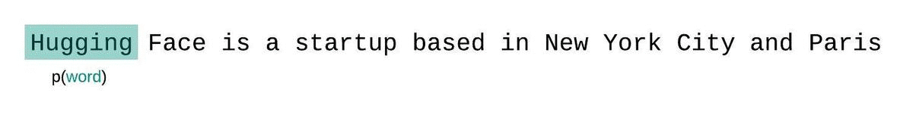
N-grams
Context is like a sliding window into the past.
Huggingface
Notes:
Keep it as a homework.

Slide 13
Context size
I went to the beach. My wife sat next to me. She was replying to some emails, and the bird stole our sandwich. Then it started raining suddenly and ___.
Longer context: predictable outcome.
Shorter context: Too unpredictable.
Notes:
What to do if the model never seen the sentence

Slide 14
Neural networks for language modeling

Slide 15
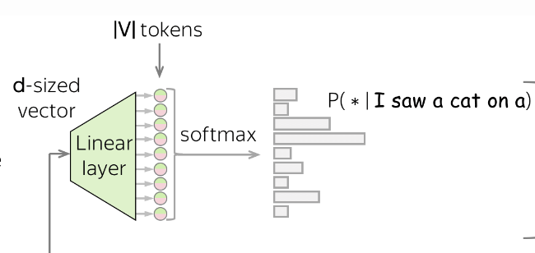
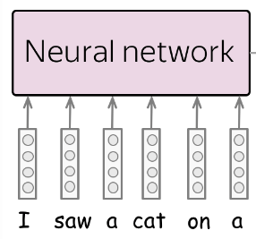

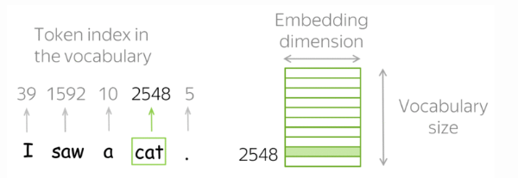
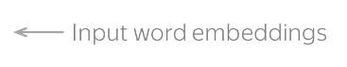
General Model Architecture
Lena-voita
Can you see any issue with inputting words in an NN?
Notes:
They need to be numbers.
What if word does not exist?

Slide 16
What is an embedding?
embeddings = representation= features = latent space.
It is a representation of your input.
Example for images.

Slide 17
Word embeddings
We ideally want words that have similar meanings to have smaller distances.
Demo
Examples:
Word2Vec (Google)
GloVe (Stanford)
Train your own!
Notes:
Try some word and click it and see closest words.

Slide 18
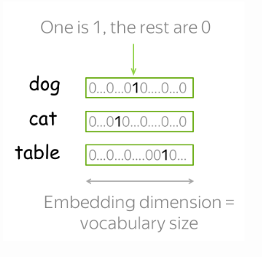
Word embeddings
Converts words to numbers
Example: One-hot encoding
Lena-voita
Issues with one-hot encoding?
Notes:
One hot: Too long. No relation between words.

Slide 19
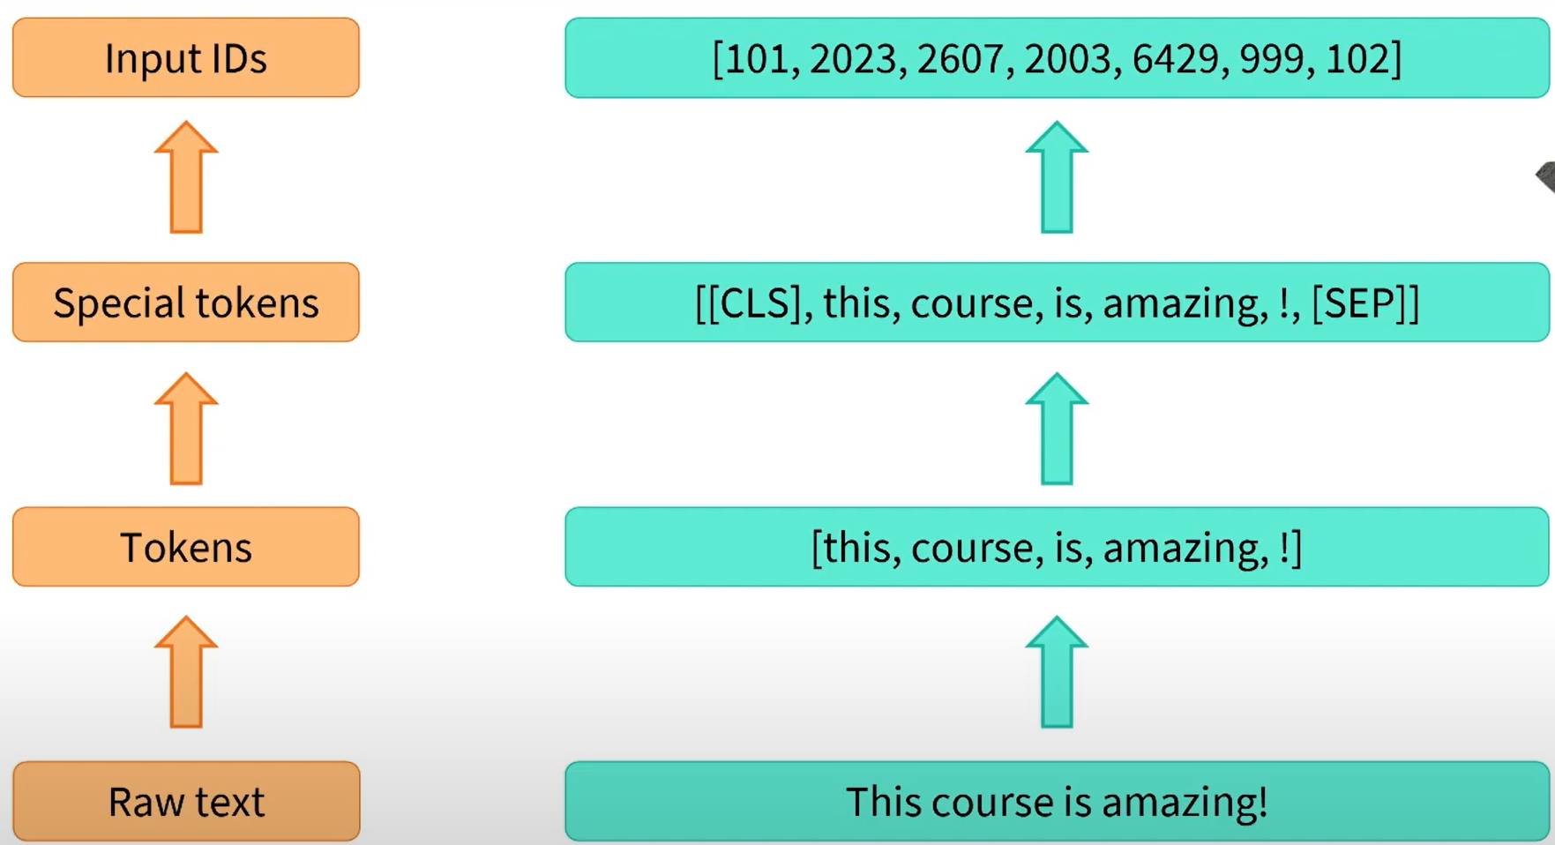
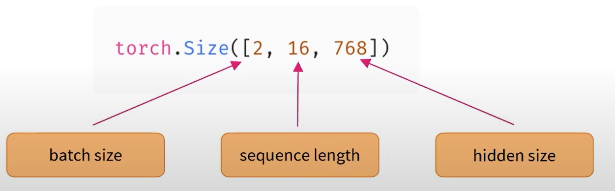
Tokenization
Huggingface
So, every time we have sentences to generate, we represent them as:
A batch of sentences (i.e., batches)
Each sentence is represented as a sequence of tokens (sequence length)
Each token is represented as a vector (hidden size)

Slide 20
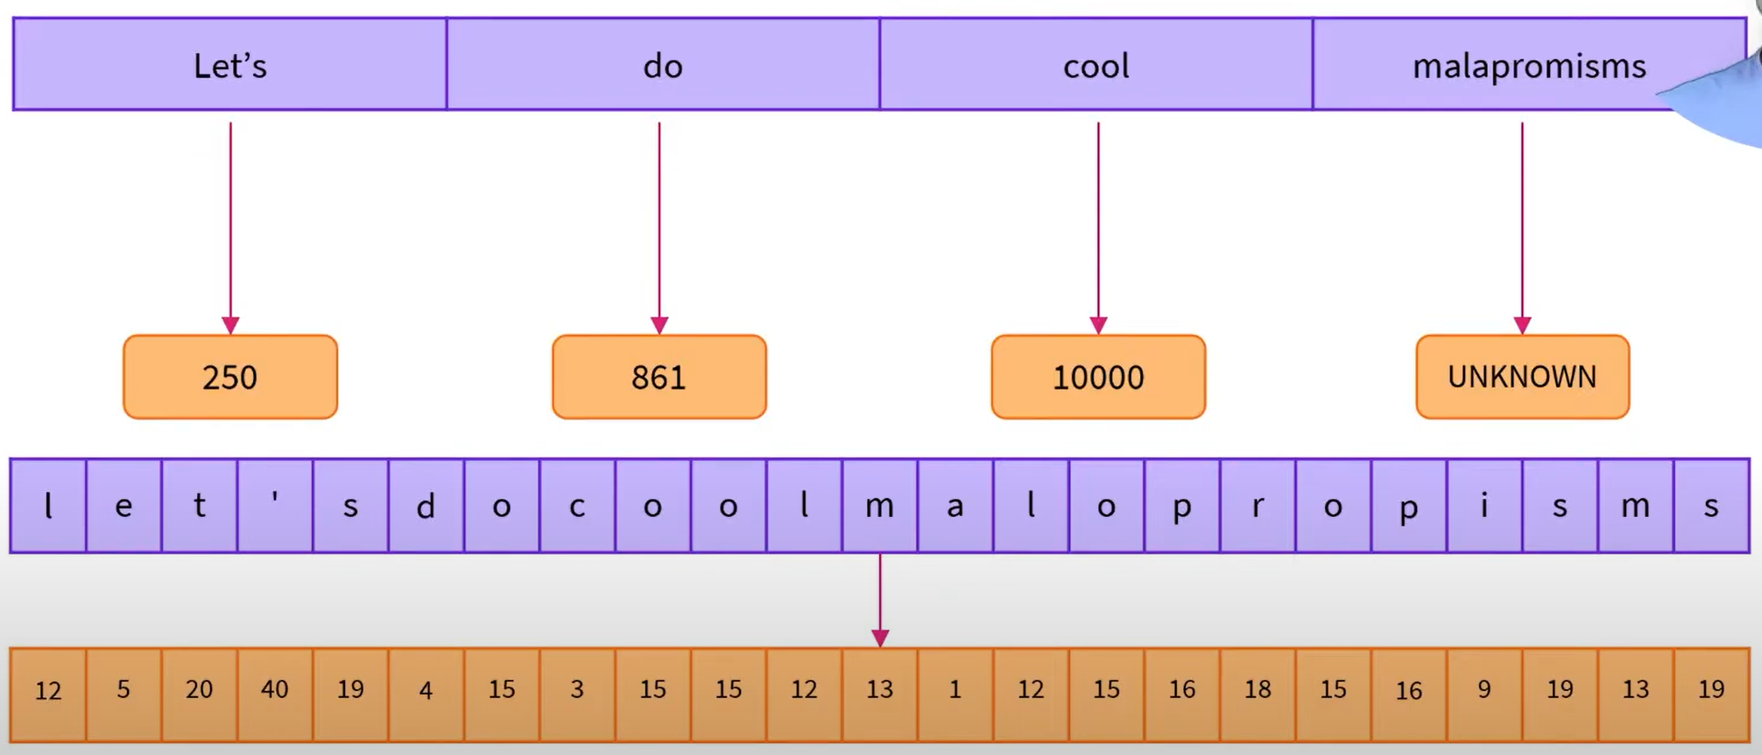
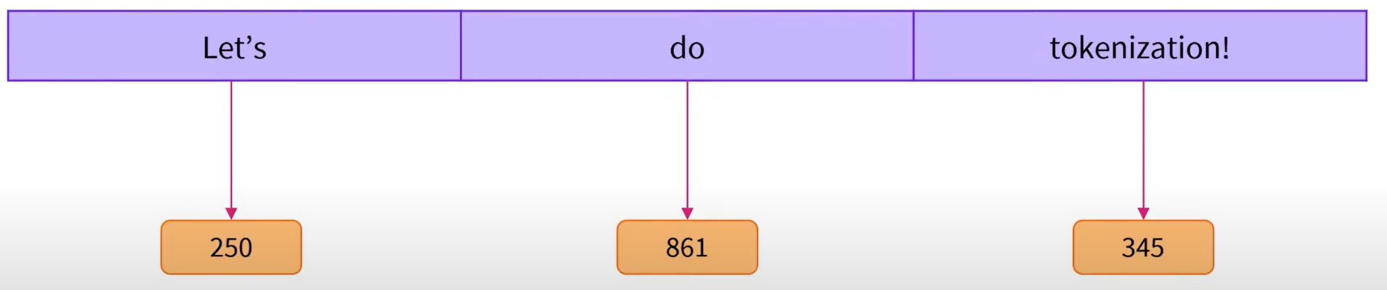
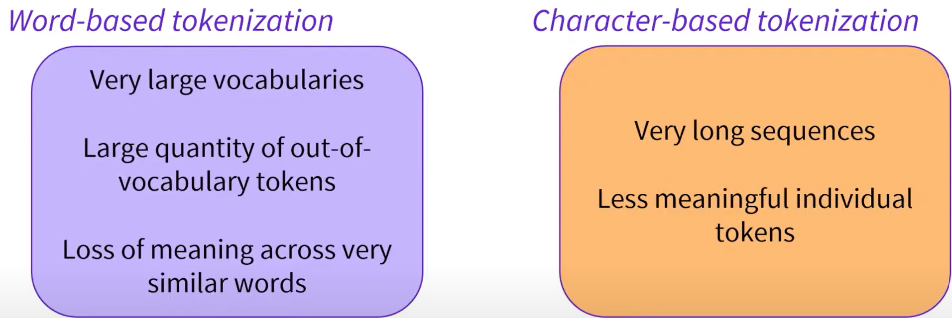
Why do word level?
Huggingface
Issues?
Issues?

Slide 21
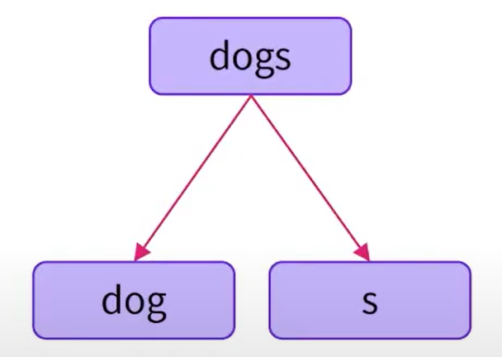
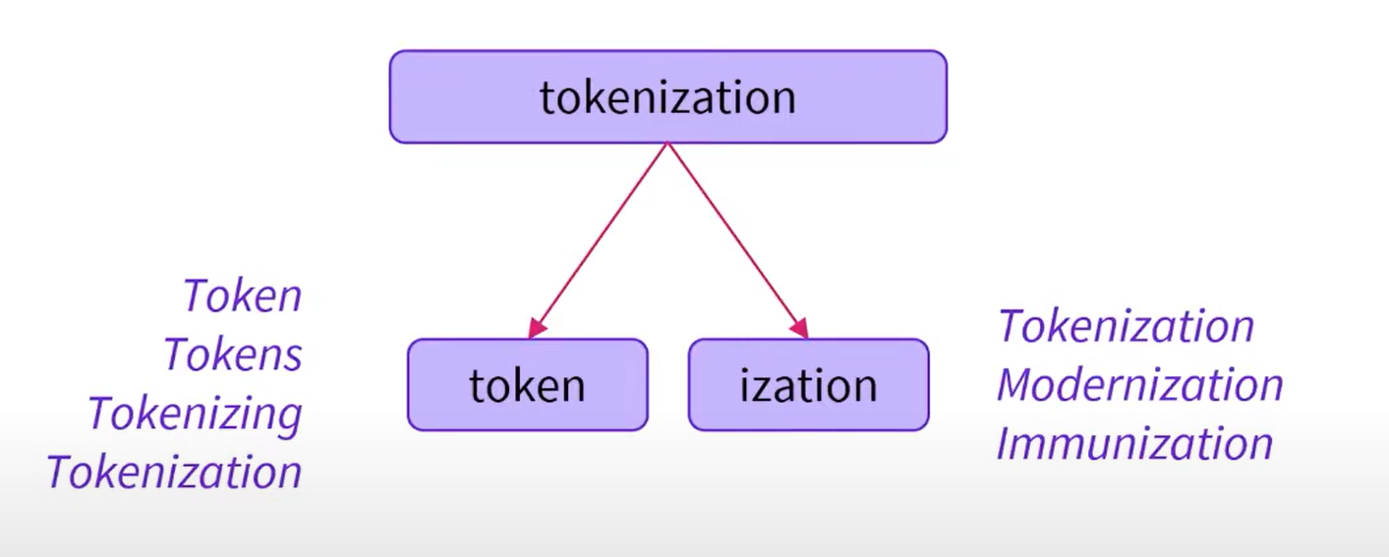
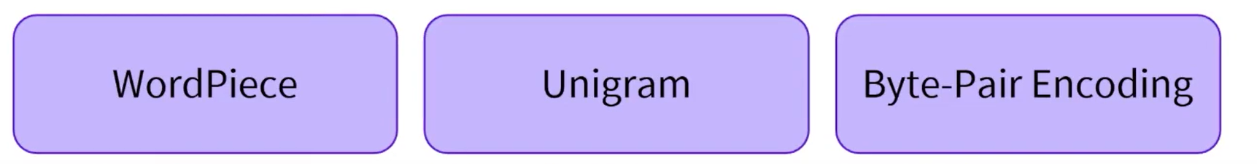
Why do word level?
How about sub-words?
Preserves word morphology.
Can represent new words.
Handles misspelling.
Examples:
Notes:
Assignment: meetign misspelling how do u think a language model still understands it?

Slide 22
Word embeddings
Word embeddings can also be used find directionality in the corpus:
Demo 1 (semantics)
Demo 2 (vector view)
Demo 3 (dimensionality)
Notes:
This will be important in bias… man strong woman….
America USA Asia…
Look at jobs by he and she and by rich and poor

Slide 23
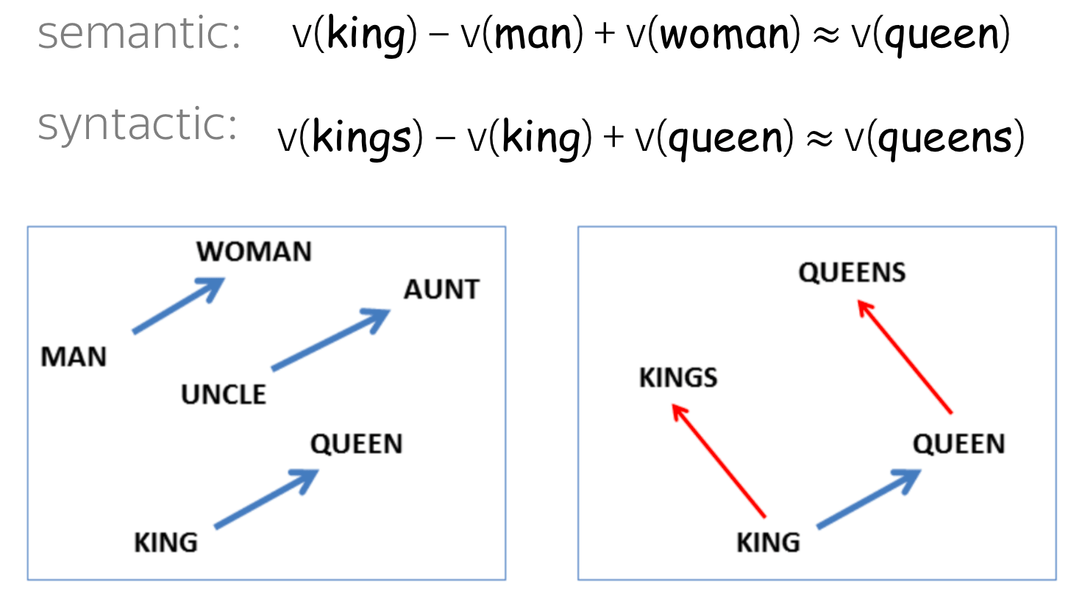
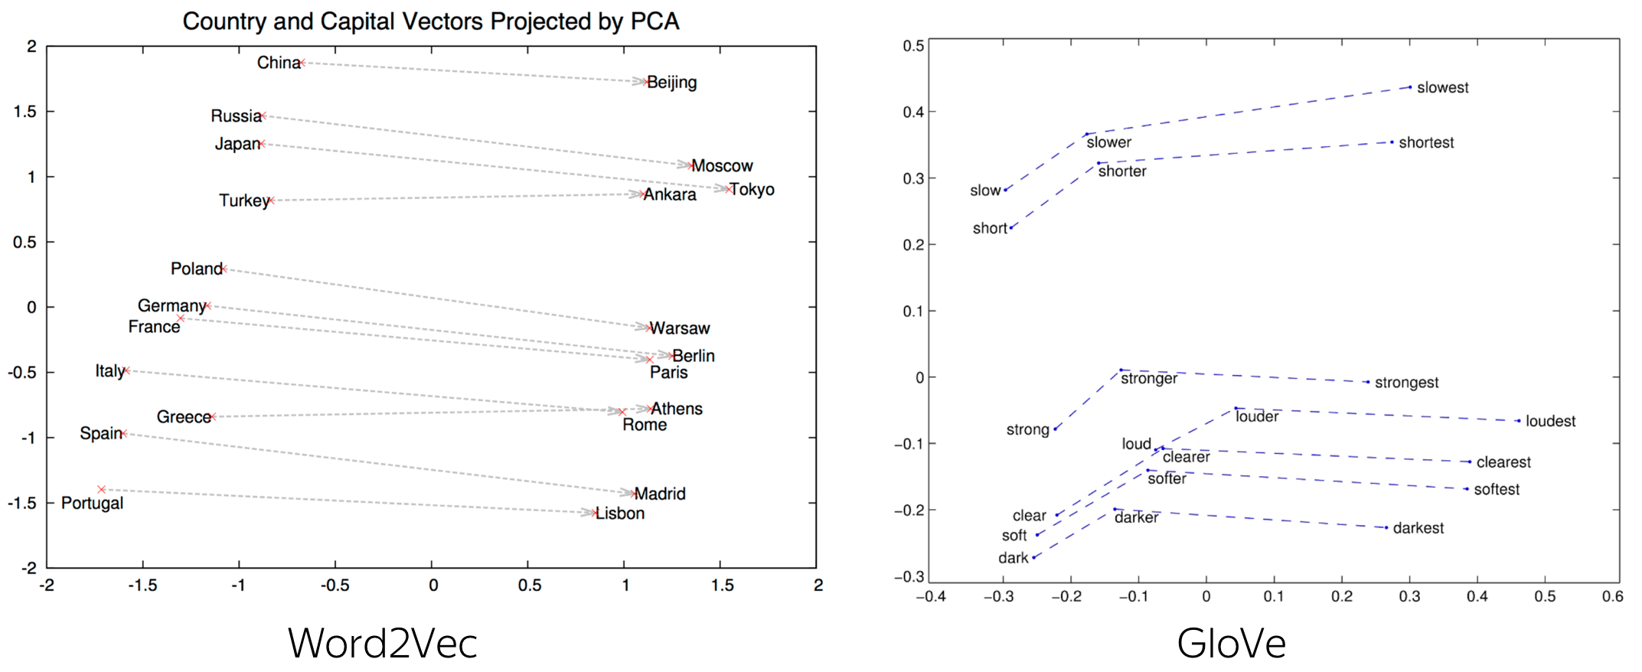
Word embeddings
Word embeddings can also be used find directionality in the corpus.
Notes:
This will be important in bias… man strong woman….
America USA Asia…
Look at jobs by he and she and by rich and poor

Slide 24
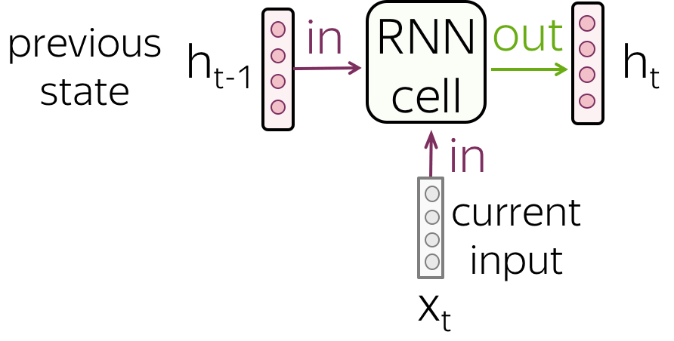
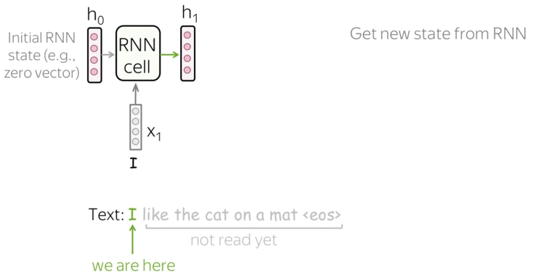
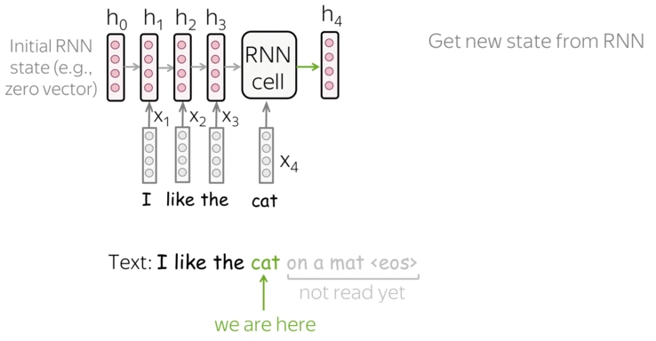
Recurrent Neural Nets (RNNs)
Combines the embeddings of previous context and current word → gives next word.
Lena-voita
……..
Notes:
Where do u think output is? Output is linear transformation.

Slide 25
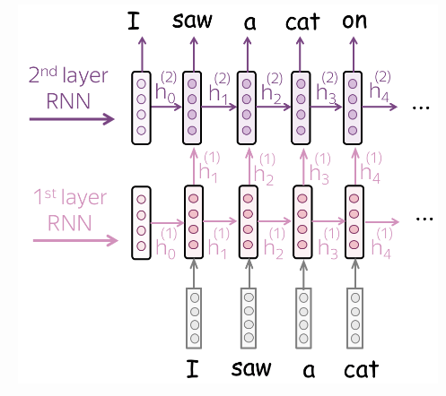
Recurrent Neural Nets (RNNs)
We can add more layers and units per layer to increase complexity.
Lena-voita
Notes:
Where do u think output is? Output is linear transformation.

Slide 26
Recurrent Neural Nets (RNNs)
Demo
Notes:
https://distill.pub/2019/memorization-in-rnns/#appendix-autocomplete

Slide 27
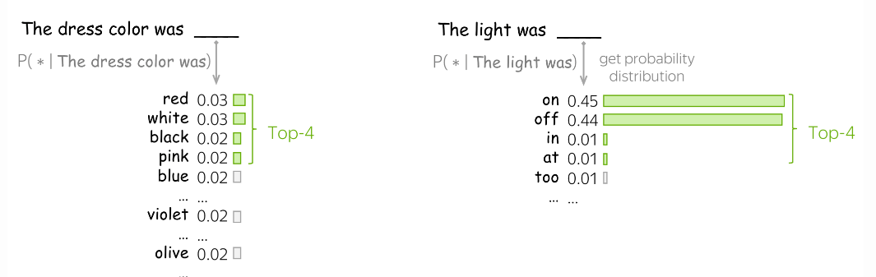
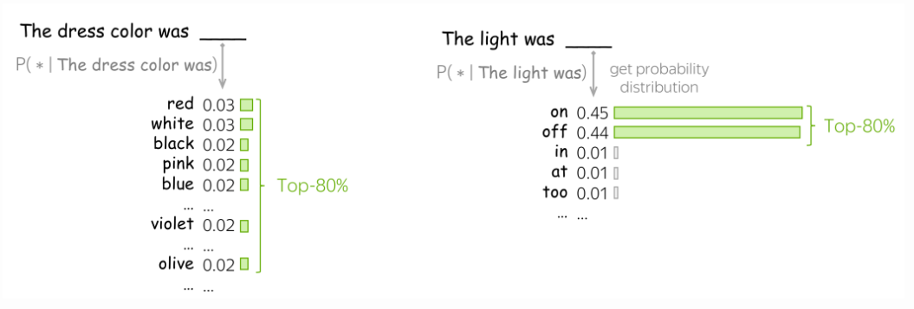
Sampling The Distribution
Always take top probability?
That makes the model deterministic (no creativity).
Alternative?
Top-k or top-p.
Lena-voita

Slide 28
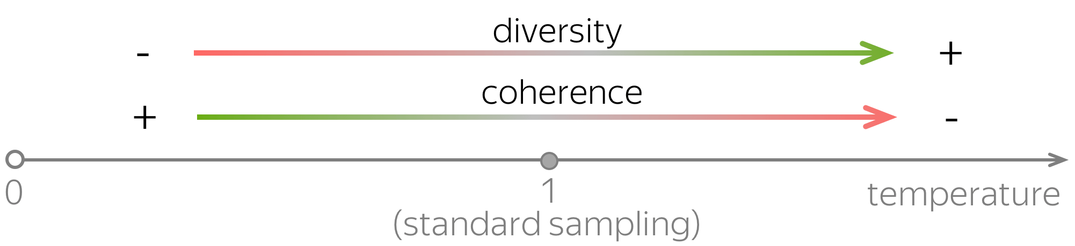
Sampling The Distribution
Some words have way higher probability than others.
This can be manually tuned through temperature.
Demo
Lena-voita

Slide 29
Measuring The Metric
What are we looking for?
A model that is not surprised by the new text it seen.
We use perplexity.
Takes values between 1 and number of possible tokens.
Smaller is better.
Demo

Slide 30
Interpretability
Different neurons have different functions
Some might have meaning others don’t
Low abstraction (verb subject) -> high level (sentiment)
https://lena-voita.github.io/nlp_course/word_embeddings.html

Slide 31
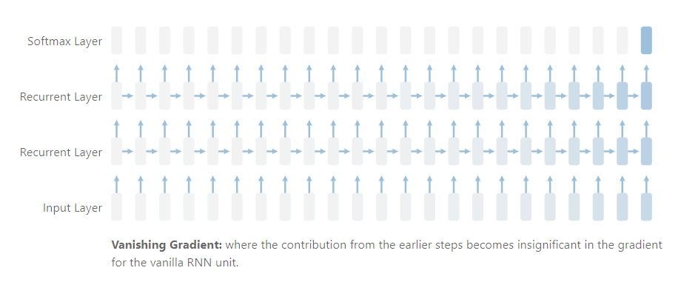
RNNs (issues)
Gradient becomes insignificant for long contexts
The network forgets early words…
It is called the “vanishing gradient” or “memorization” problem.
RNNs have an issue memorizing long contexts.
distill.pub

Slide 32
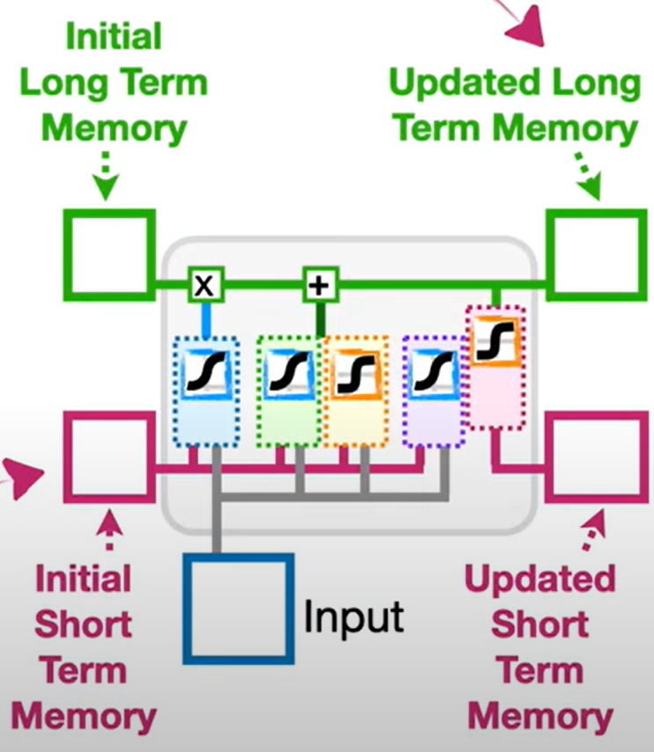
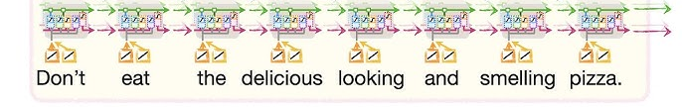
Attempted solution: LSTM
Instead of one representation, let’s have two!
One for short-term memory
And one for long-term memory.
Somewhat of an improvement.
StatQuest
Notes:
Maybe example that it could still go wrong?: https://transcranial.github.io/keras-js/#/imdb-bidirectional-lstm (doesn’t seem to work)

Slide 33
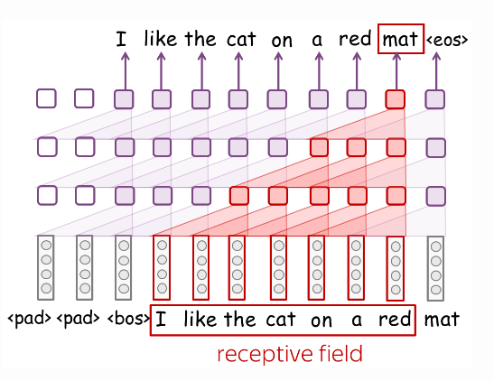
There are other similar models
GRUs, CNNs…
But we will not talk about them here.
CNN

Slide 34
Question for next week…
What limitations are inherent in traditional NLP models, and how might they be addressed?

Slide 35
Assignment

